Slide 1

Understanding Windows container networking in Kubernetes using a real story
Cindy Xing, Huawei
Dinesh Kumar Govindasamy, Microsoft

Slide 2


Our 35min Journey: Step by Step
Windows Container Networking Architecture
Kubernetes Networking - Windows
Windows CNI Plugin
Demo & Troubleshooting
+

Slide 3
Goals
Understand windows container network inside out
How to author a windows container CNI plugin
How to troubleshoot windows container network issue(s)

Slide 4
Windows Container Architecture
Public Clouds
Azure, GCE, AWS, Huawei etc…
OnPrem Environments
Docker EE, OpenShift, Rancher, DIY Kubernetes
Kubelet/KubeProxy
KubeCTL/REST Interface
Docker Shim/ContainerD
CNI Plugin
HCSSHIM
Operating System
Host Compute Service
Host Network Service
Other OS Functionality
Control Groups
Job Objects
Namespaces
Object Namespace, Process Table, Networking
Layer Capabilities
Registry, Union like filesystem extensions

Slide 5

Container Networking Basics
Network Namespace
Bridge and IP Routing
IP links
IPVS and IP Table Rules
VSwitch
vNIC’s and VSwitch/VFP Ports
Firewall and VFP Rules
TCPIP Compartments

Slide 6
Windows Container Networking
POD NS1
VMSwitch
Virtual Network
Container Namespace
Container Endpoint
NAT & Load balancer
Bare Metal Networking
192.168.0.6 | 00:15:aa:bb:cc:a1
Ethernet
ROOT
Namespace
vEthernet
VFP
ACLS, QoS
VXLAN ENCAP, DECAP
SNAT, DNAT, LBNAT
Forwarding
Ethernet
192.168.0.5 | 00:15:aa:bb:cc:dd

Slide 7
Virtual Filtering Platform - Overview
Container
Metering
Egress
Ingress
Egress -> Inbound
ACLs
VNET
Ingress -> Outbound
SLB
Egress
Ingress
Inbound (Egress)
Outbound (Ingress)
VFP Translates L2 extensibility (ingress/egress to switch) to L3 extensibility (inbound/outbound to VM)
Notes:
VFP : Ports, Layers, Groups and Rules
Encap/Decap
Loadbalancing
NAT
QoS
ACL

Slide 8
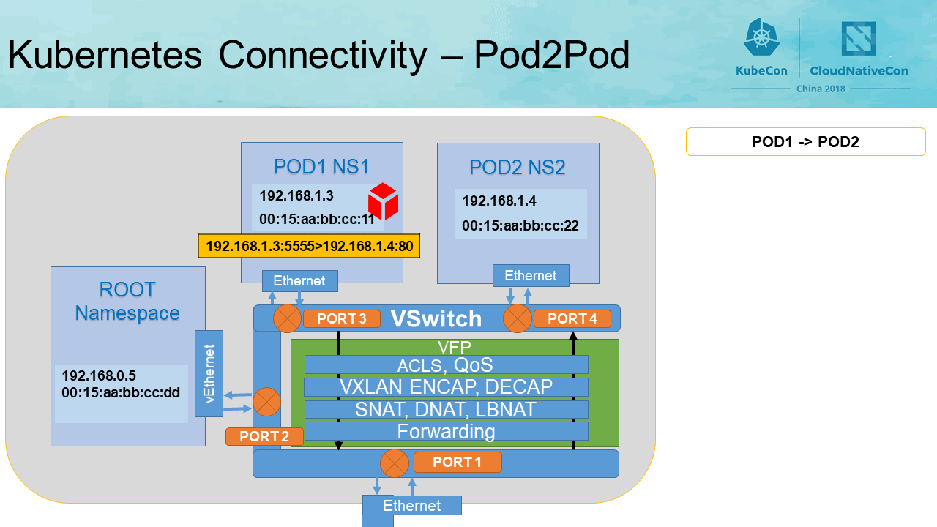
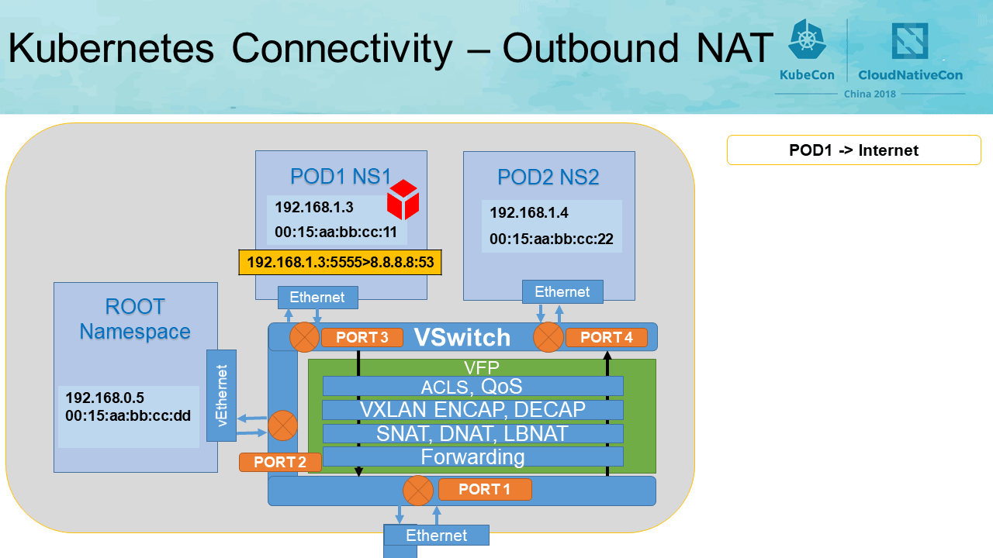
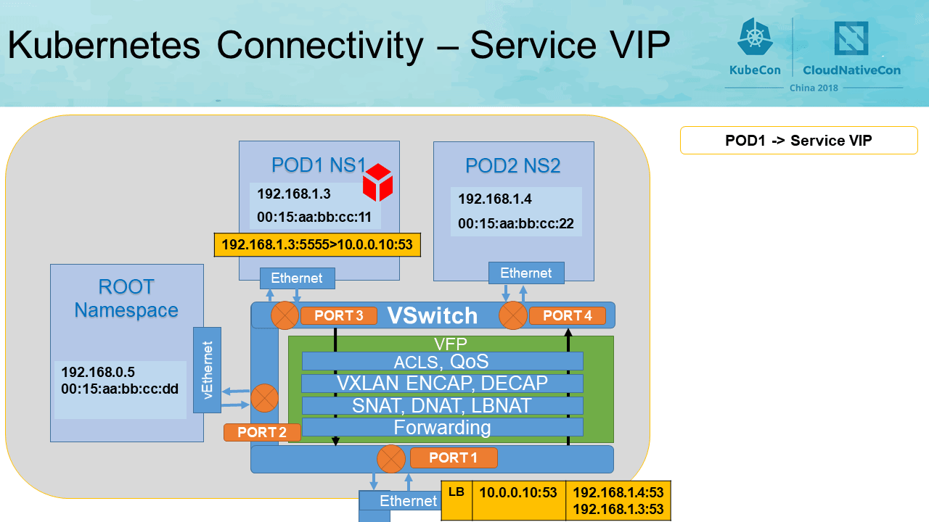

Slide 9
Huawei Windows Container Cluster
Huawei K8s Cluster
K8s Master Node (Linux)
K8s Worker Node (Windows) …
ICAgent
ICAgent
Kubelet
Kubelet
CRI
CNI
CSI
CRI
CNI
CSI
Container Runtime
Storage Plugins
(EVS, OBS)
Container Runtime
Storage Plugins
(EVS, OBS)
Ican CNI & IPAM
Ican CNI & IPAM
Kube-proxy
Kube-proxy
Linux OS
IPTABLES/IPVS
Windows OS
Host Compute Service (HCS)
Host Network Service (HNS)
VSWITCH
VFP
Huawei SDN

Slide 10
K8s + CRI + CNI
Docker run a pause container
DockerShim calls Docker for pod netns
Kubelet starts DockerShim
Kubelet calls RunPodSandbox
CRIShim calls CNINetworkPluginMgr to SetupPod
CNINetworkPluginMgr run CNIPlugin Add command to connect pod to the virtual network
DockerShim
Pod
CRI Shim
Docker Engine
C1
C2
GRPC Server
Pause
EP
Kubelet
GRPC Client
CNINetworkPluginMgr
CNIPlugin
Network

Slide 11
CNI and CNIplugin
What is CNI
What is CNIPlugin
What CNIPlugin does
How to implement CNIPlugin
How to run CNIPlugin
POD1 NS1
VSwitch
Ethernet
ROOT
Namespace
VFP
ACLS, QoS
VXLAN ENCAP, DECAP
vEthernet
SNAT, DNAT, LBNAT
Forwarding
Ethernet
Notes:
CNI: API between container runtime and network plugin
CNIPlugin: executable which adds container to network or removes it from network
With CNIPlugin, a pod gets assigned IP and mac address; connects to the virtual network, and have default route configured; or gets disconnected from the virtual network and IP released
To implement Windows CNIPlugin, one needs to call Microsoft HCSShim APIs to Add/Delete pod to/from the virtual network
To execute the CNIPlugin, one needs to author the configuration file, together with the commandline parameter

Slide 12
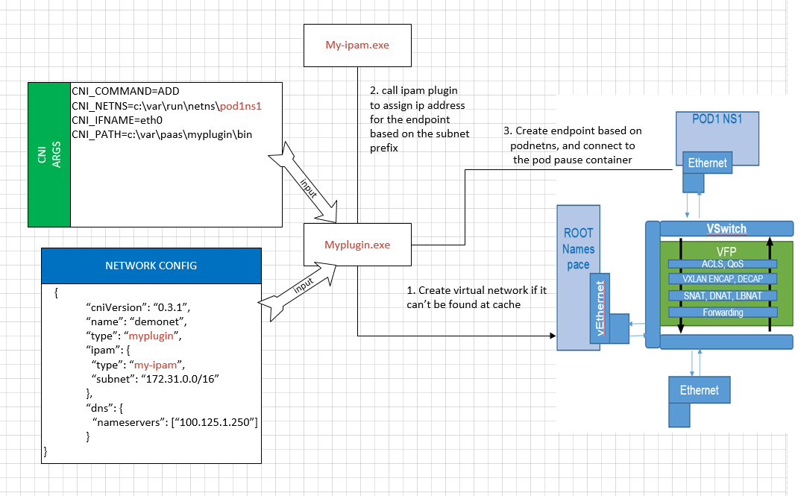
CNIPlugin Execution Flow: Add

Slide 13
Host Networking Service API’s
import "github.com/Microsoft/hcsshim/hcn"
Create LoadBalancer :
func (loadBalancer *HostComputeLoadBalancer) Create() (*HostComputeLoadBalancer, error) {
jsonString, err := json.Marshal(loadBalancer)
if err != nil {
return nil, err
}
loadBalancer, hcnErr := createLoadBalancer(string(jsonString))
if hcnErr != nil {
return nil, hcnErr
}
return loadBalancer, nil
}
Delete LoadBalancer:
func (loadBalancer *HostComputeLoadBalancer) Delete() (*HostComputeLoadBalancer, error) {
if err := deleteLoadBalancer(loadBalancer.Id); err != nil {
return nil, err
}
return nil, nil
}
import "github.com/Microsoft/hcsshim/hcn"
Create Endpoint :
func AddHcnEndpoint(epName string, expectedNetworkId string, namespace string,
makeEndpoint HcnEndpointMakerFunc) (*hcn.HostComputeEndpoint, error) {
createEndpoint := true
hcnEndpoint, err := hcn.GetEndpointByName(epName)
if hcnEndpoint != nil && hcnEndpoint.HostComputeNetwork == expectedNetworkId {
createEndpoint = false
}
if createEndpoint {
if hcnEndpoint, err = makeEndpoint(); err != nil {
return nil
}
if hcnEndpoint, err = hcnEndpoint.Create(); err != nil {
return nil }
}
hcn.AddNamespaceEndpoint(hcnEndpoint.Id, namespace)
return hcnEndpoint, nil
}
Delete Endpoint :
func RemoveHcnEndpoint(epName string) error {
hcnEndpoint, err := hcn.GetEndpointByName(epName)
if err != nil {
return err
}
if hcnEndpoint != nil {
hcnEndpoint, err = hcnEndpoint.Delete()
if err != nil {
return err
}
}
return nil
}
import "github.com/Microsoft/hcsshim/hcn"
Create Network :
hcnNetworkConfig = &hcn.HostComputeNetwork{
Name: info.Name,
Type: hcn.NetworkType(info.Type),
Ipams: []hcn.Ipam{
hcn.Ipam{
Type: "Static",
Subnets: subnets,
},
},
Dns: hcn.Dns{
Suffix: info.DNS.Suffix,
ServerList: info.DNS.Servers,
},
SchemaVersion: hcn.SchemaVersion{
Major: 2,
Minor: 0,
},
Policies: hcnPolicies,
}
Delete Network :
hcnNetwork, err := hcn.GetNetworkByID(networkID)
if err != nil {
return err
}
_, err = hcnNetwork.Delete()
import "github.com/Microsoft/hcsshim/hcn"
Create Namespace :
func NewNetNS() (*NetNS, error) {
temp := hcn.HostComputeNamespace{}
hcnNamespace, err := temp.Create()
if err != nil {
return nil, err
}
return &NetNS{path: string(hcnNamespace.Id)}, nil
}
Delete Namespace :
func (n *NetNS) Remove() error {
n.Lock()
defer n.Unlock()
if !n.closed {
hcnNamespace, err := hcn.GetNamespaceByID(n.path)
if err == nil {
hcnNamespace.Delete()
n.closed = true
}
}
if n.restored {
n.restored = false
}
return nil
}
HCN Network
HCN Namespace
HCN Endpoint
HCN Load Balancer

Slide 14
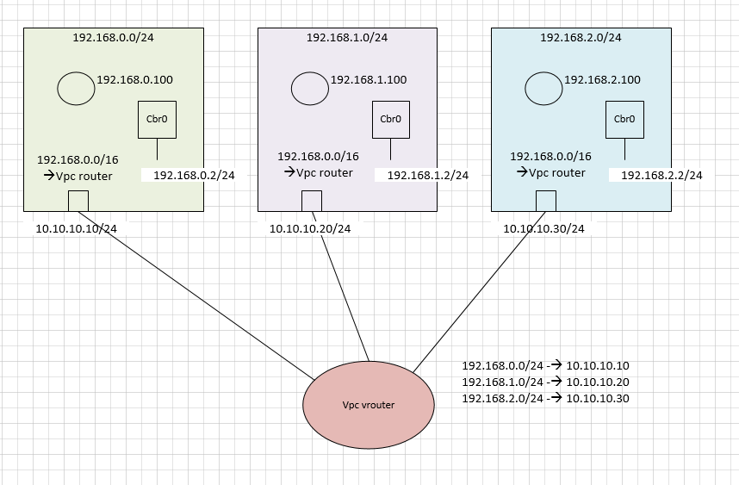
Huawei Windows Container Network
L2Bridge mode together with L3 overlay Routing
Cbr0 endpoint is used as the default GW for each pod with forwarding enabled
https://github.com/containernetworking/plugins/tree/master/pkg/hns
https://github.com/containernetworking/plugins/tree/master/plugins/main/windows

Slide 15
Demo
Create a Windows Cluster
Check CNI plugin
Setup docker, pull customer application (IIS + ASP.NET) image
Deploy the app
Collect tracing
Walk through the trace

Slide 17
Windows Network Drivers for Containers
NAT MAC and IP Rewritten | Overlay Encapsulated with an outer header | L2 Bridge MAC rewritten, IP visible on the underlay network | L2 Tunnel MAC rewritten, IP visible on the underlay network
Nuances between L2 bridge and “tunnel”
L2 Bridge | “L2 Tunnel” (Public Cloud mode)
Container to Container traffic bridged inside the container host | All traffic forwarded to External router or (Azure) Fabric host
Network policies not applied to intra-host traffic between containers | Network policies for each individual endpoint enforced on physical host
Notes:
If you want to configure your container to use underlay network, then you would be using MacVLAN driver mode in Linux. In windows, we have 3 different network modes that enables you to use underlay network. For all these network modes, we create an external VSwitch. An external VSwitch enables your containers to connect to both host partition and physical network.
In transparent network mode, we let container MAC address pass though the VSwitch and let physical network learn the container macs. You need to enable Mac spoofing on the network interface if you are running transparent network mode on a virtual machine.
In case of L2 bridge mode we rewrite the container Mac with the container host Mac. This helps in not flooding the physical network with all those containers. Both l2 bridge and l2 tunnel modes are more suited for cloud environments.
In l2 bridge mode the container to container traffic is bridged within the container host whereas in l2 tunnel mode the traffic is tunneled to the external router in azure case in the l1 fabric host and then hair pinned back to the destination container. This mode enables you to apply SDN policies on the host for containers.
L2 Tunnel introduces additional network latency with intra-container traffic on the same host due to hair-pinning, however, richer network policy model

